Slide 1
Single Shot Detection

Slide 2
SSD(Single Shot Multi-Box Detection)
Single Shot: Object localization and classification is done in single forward pass of network.
MultiBox: Technique for bounding box regression
Detector: Classify the detected objects

Slide 3
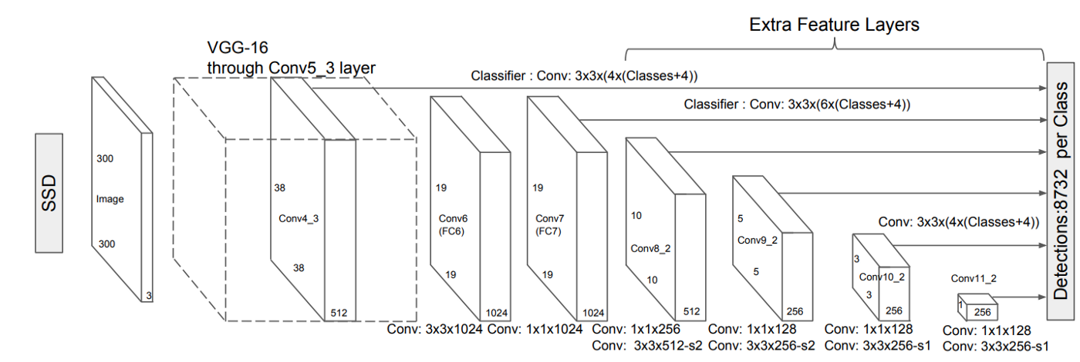
Architecture

Slide 4
SSD
The architecture
We use the set of auxiliary convolutional layers from Conv6 layer onwards instead of fully connected layers. e of SSD is built based on the VGG-16 architecture.
The reason of using VGG-16 as foundational network is its high quality image classification and transfer learning to improve results.
Using the auxiliary convolutional layers we can extract features at multiple scales and progressively decrease the size at each following layer.

Slide 5
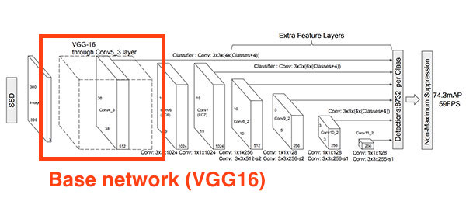
VGG-16 in SSD

Slide 6
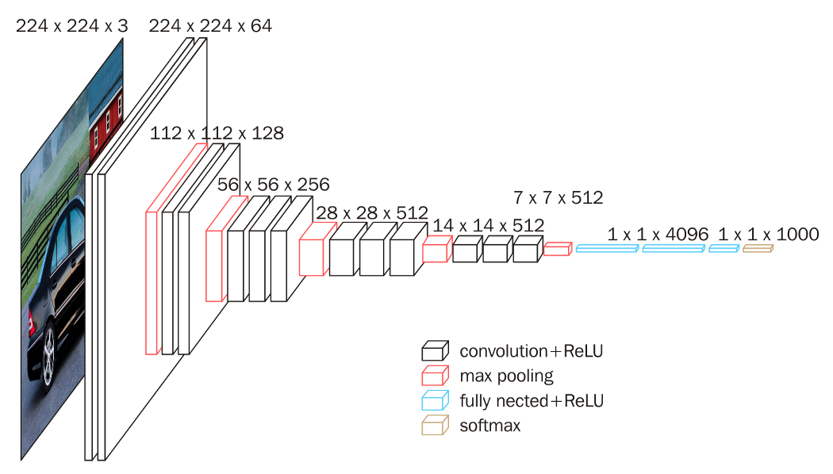
VGG-16

Slide 7
Working Mechanism
To train our algorithm, we need a training set that contains image with objects and those objects must have bounding boxes on them.
Learning this way, the algorithms learn how to put rectangle on the object and where to put.
We minimize the errors between inferred bounding boxes and ground truth to optimize our model to detect the object correctly.
Unlike in CNN, we don’t only predict if there is an object in the image or not we also need to predict where in the image the object is.
During training the algorithm learn to adjust the height and width of the rectangle in the object.

Slide 8
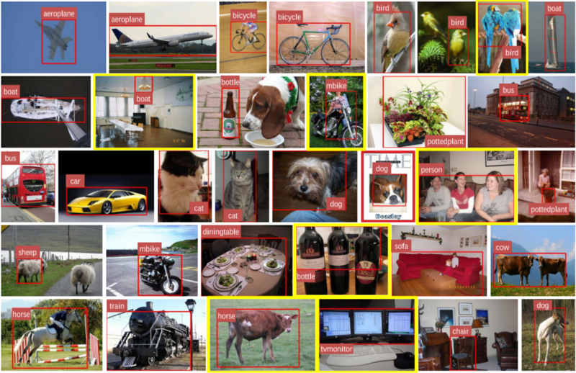
Datasets(Pascal VOC and COCO)

Slide 9
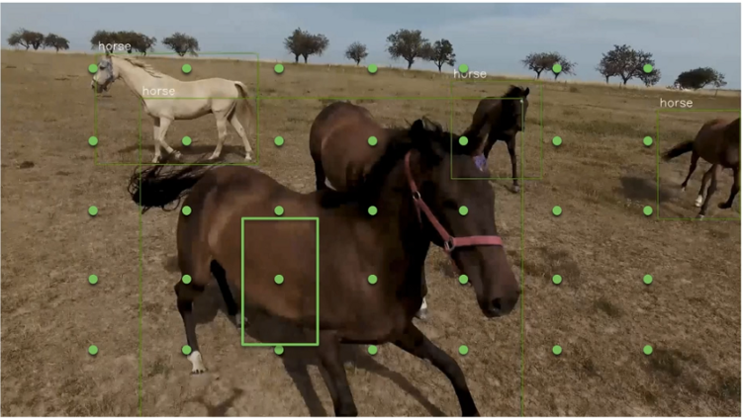
Dealing With Scale Problem

Slide 10
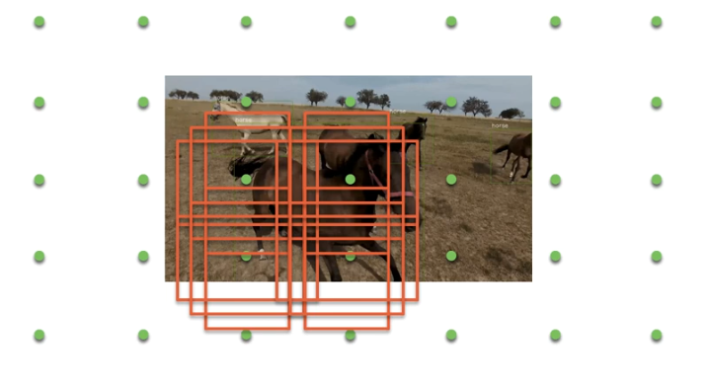
Improvement in SSD

Slide 11
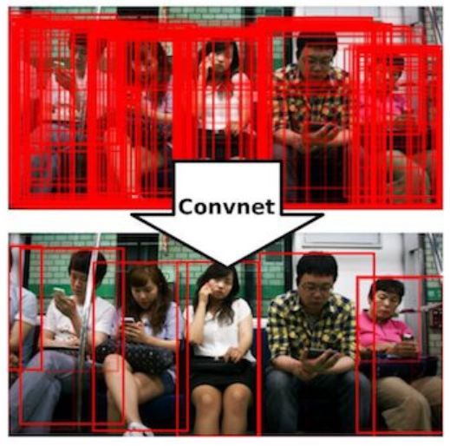
Non-Maximum Suppression (NMS)

Slide 12
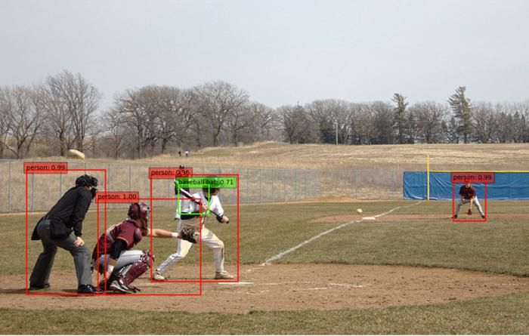
SSD Applied

Slide 13
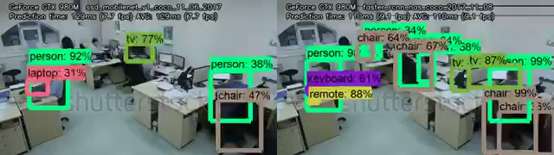
SSD Output

Slide 14
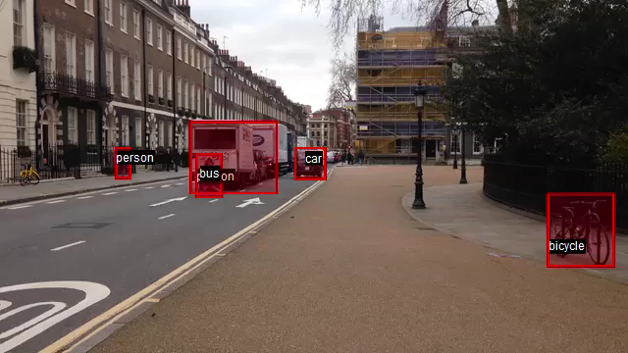
SSD output

